Slide 1
Practice Being SAFe Or You Will Fall
By: Matt Takane

Slide 2
Matt Takane
Senior Consultant
5 years at Red Hat
3 years doing Agile development and management
Test Manager for automated test framework
Worked as a Scrum Master, Release Train Engineer and Agile Coach to individual teams of people and entire programs of 150+ people
Part of the Agile and DevOps Community of Practice
Heading up Scaled Agile Framework training within Red Hat
Coaching consultants/managers on the ground in Agile and best practices

Slide 3
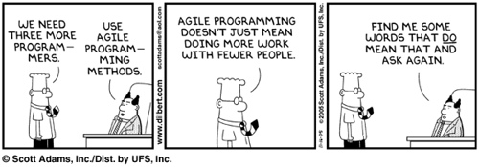
Agenda
Waterfall Overview
Agile History
How to excel in Team Agile
How to Scale Agile

Slide 4
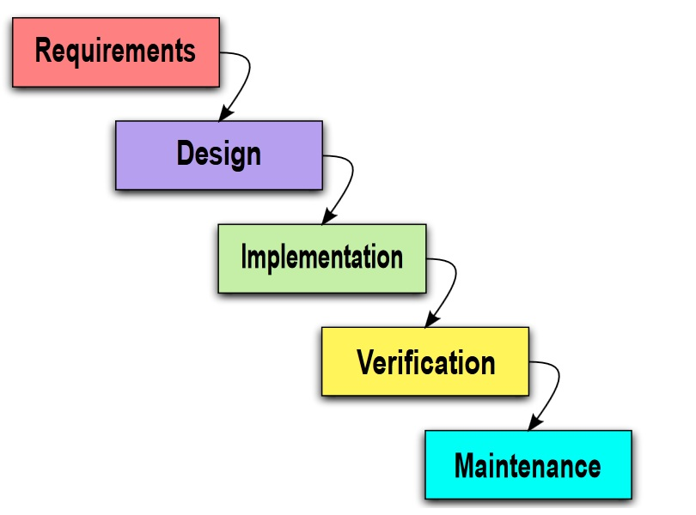
Waterfall
First adopted in the 1970’s based on an article by Winston W. Royce
Linear approach to software development that follows a sequence of events
Typical sequence
Gather and document requirements
Design
Implement the solution
Perform validation testing
Deliver the finished product
Maintenance
Notes:
The first formal description of the waterfall model is often cited as a 1970 article by Winston W. Royce,^{[3][4]} although Royce did not use the term waterfall in that article. Royce presented this model as an example of a flawed, non-working model; which is how the term is generally used in writing about software development—to describe a critical view of a commonly used software development practice.

Slide 5
Waterfall – The Good
At the beginning of the project, both developers and customers agree on what will be delivered and when
Software can be designed based on initial ideas and understanding of all software deliverables (so long as they don’t change)

Slide 6
Waterfall – The Bad
Time consuming to try and gather ALL requirements and design, before starting development
Timidness by the customer to provide too many details so early in the project
Delivery of the end product may match the initial requirements, but does that match what the customer needs/wants at the time of delivery?
Most of the time it does not
All economic value to the customer is delivered at the end of the Project
When requirements change, it typically forces a change request and potential project plan shift in price/date/resources
Scope Creep based on vague initial requirements

Slide 7
Waterfall – Making the best of
Ask questions in regards to vague scope
Look to your Service Delivery Managers (SDMs) to help work with the client on expectations
Try to setup intermittent checkpoints and demos as you develop the solution
Try to deal with facts, versus wishful thinking and date driven development
Ie: Manager says “here is an amount of scope, I would like it done by Wed. Is that possible?”. Look to identify scope and have those doing the work identify when it may be completed and have daily sync up meetings to assess progress and remaining time.

Slide 8
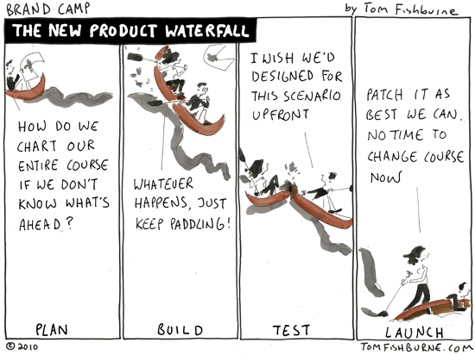

Slide 9

Keeping Pace
Our methods must keep pace with an increasingly complex world
We’ve had Moore’s Law for hardware, and now software is eating the world
Our development practices haven’t kept pace; Agile shows the greatest promise.
We need a new approach that harnesses the power of Agile and Lean and applies to the needs of the largest software enterprises

Slide 10

We thought we’d be programming like this:

Slide 11
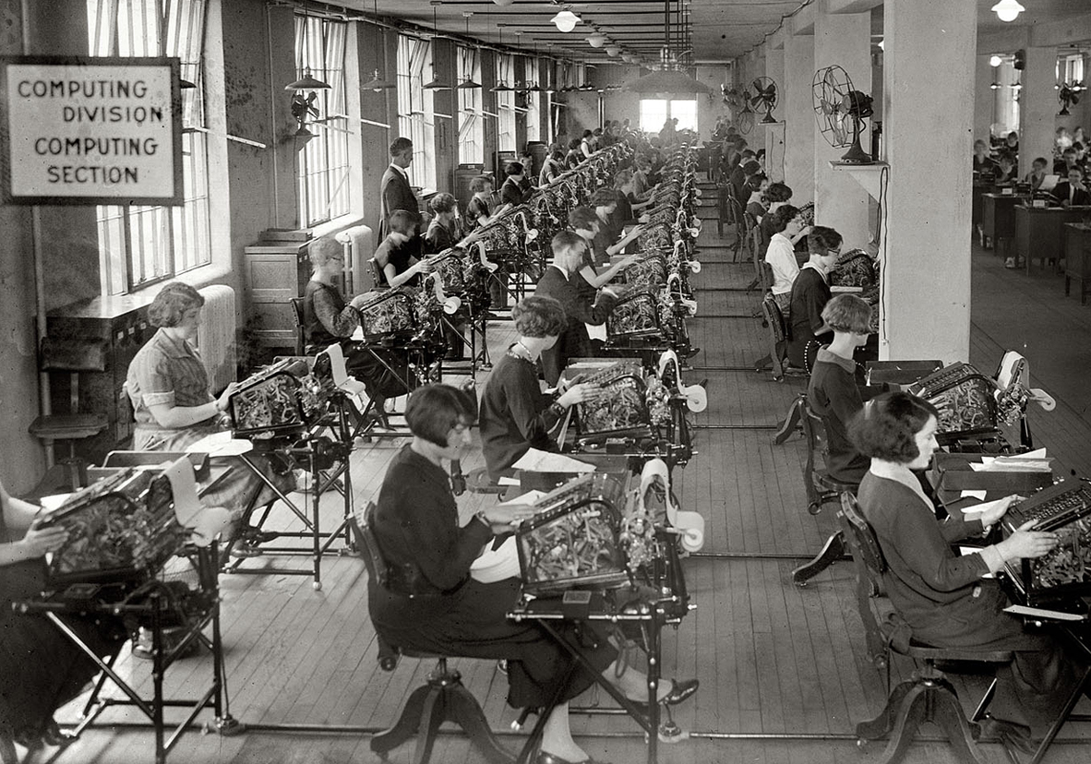
But sometimes it feels like this:
Library of Congress

Slide 12
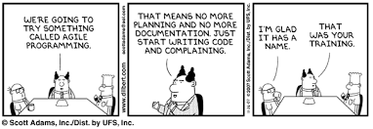
Agile
February 2001, a group of software developers convened to form what is known today as the Agile Manifesto
Programming methodologies like XP, Scrum, RAD, and Spiral all contributed
Focuses on incremental delivery, collaboration and high-communication techniques to provide an easier manner to deliver software projects

Slide 13
The Agile Manifesto
We are uncovering better ways of developing software by doing it and helping others do it.
Through this work we have come to value:
Individuals and interactions over processes and tools
Working software over comprehensive documentation
Customer collaboration over contract negotiation
Responding to change over following a plan
That is, while there is value in the items on the right, we value the items on the left more.
agilemanifesto.org

Slide 14



Agile Team Members
Five to nine team members, three Scrum roles
Runs team meetings, enforces agile behavior
Removes impediments; protects the team from outside influence
Scrum Master
Defines and accepts stories
Acts as the customer for developer questions
Works with product management to plan releases
Product Owner
Creates and refines user stories and acceptance criteria
Defines/Builds/Tests/Delivers stories
Develops and commits to Team Objectives and Sprint Plans
Developers/ Testers

Slide 15
Key Agile Terms
Iteration (Sprint) – timeboxed cadence to deliver planned scope of work. Typically 1-4 weeks of time.
Daily Stand Up (DSU) – daily touchpoint to have alignment between the team. Typically 15 minutes.
Grooming – timeboxed cadence to discuss future scope
Demo – demonstration of working software at the end of each iteration
Retrospective – reflection by the team regarding the performance and experiences during the iteration
Backlog – Single source of prioritized work items that the team takes from.
Stakeholders – key people who are have a vested interested in the solution created by the team
User Stories – small independent work items that are short, simple description of a feature told from the perspective of the person who desires the new capability

Slide 16
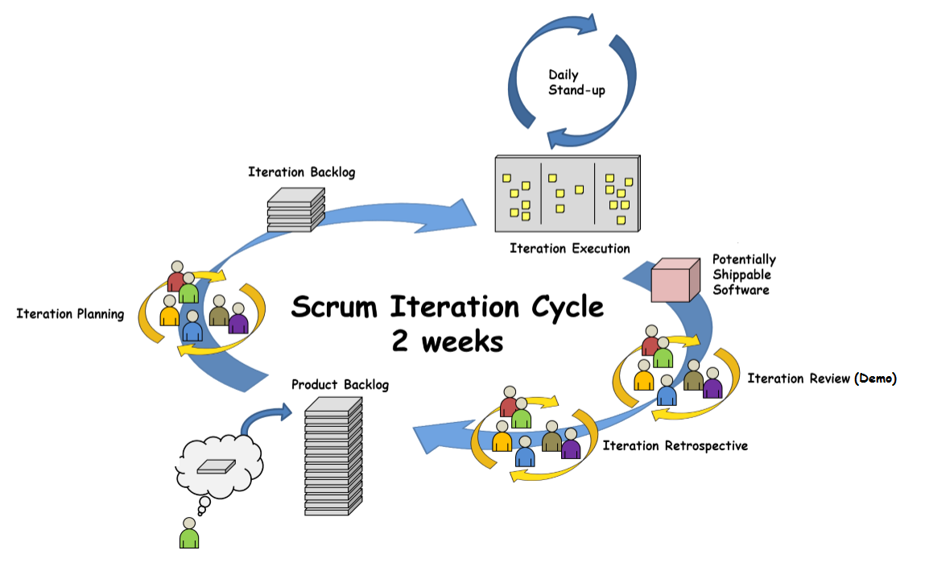
AGILE – TEAM LEVEL APPROACH

Slide 17
Apply Fast Learning Cycles
Product development is the process of converting uncertainty to knowledge. Fast feedback accelerates knowledge.
Improves learning efficiency by decreasing the time between action and effect
Reduces the cost of risk-taking by truncating unsuccessful paths quickly
Facilitated by small batch sizes
Requires increased investment in development environment
The shorter the cycles, the faster the learning.
Do
Check
Adjust
Plan
PDCA
The iterative learning cycle
Principles of Product Development Flow, Don Reinertsen
Plan. Do. Check. Act. (Adjust), W. Edwards Deming, Walter Shewhart, et al.

Slide 18
Achieve Better Economic Value
Early delivery provides fast value with fast feedback
Fast feedback
Waterfall
Value Delivery
Incremental
Time

Slide 19
Red Hat Consulting DevOps Continuous Delivery Model
 | 1 (Initial) | 2 | 3 (Improved) | 4 | 5 (Optimizing)
Culture & Organization | Teams organised based on platform/technology. Defined and documented processes. Low cooperation or power-oriented. | Agile Adoption One backlog per team. Remove team boundaries. Share the pain. Modest cooperation or rule-oriented. | Scaled Agile Approach (SAFe or other) Extended team collaboration. Remove boundary dev/ops. Common process for all changes. | Cross-team continuous improvement. Teams responsible all the way to production. | Cross functional teams. High cooperation or performance-oriented.

Slide 20
How to hit the ground running

Slide 21
What do I do?!
Understand key terms (see handout)
Attend and participate in ceremonies
Planning, Grooming, DSU, Demo, Retro
Ask Questions throughout
Keep in mind continuous improvement
Maintain open communication streams with EVERYONE
Reduce Context Switching and having too much Work in Progress (WIP)
Don’t try to multi-task

Slide 22

Exercise: Context Switching
Notes:
The first time you will write each row before proceeding to the next:
A I 1
B II 2
C III 3
The second time you will write each column before moving to the next
Want to have 3 columns.
First column is the alphabet A-Z
Second column are roman numerals 1-26
Third column are the numbers 1-26
We will write these out twice
The goal: write all three columns as quickly as possible
Notes:
Point of exercise is to demonstrate how much quicker it is to not have to switch contexts and just complete individual pieces of work. Having solid time to complete the work is necessary. Think about how you always hear about “getting into the zone” and the amount of work you get done when you dedicate blocks of time to complete your CS labs.

Slide 23
Who do I Engage?
Team Members
Look to create a positive experience
Other Team Members
Collaboration across teams is a good thing.
Scrum Master
Good person to also discuss delivery method and process questions
Product Owner
Always ask this person if you don’t understand something or need business direction.
Notes:
Team Members
Always talk with your team, they are your support group and those who help you and can use your help.
Look to create a positive experience
Scrum Master
Talk to this person regarding issues/impediments that you run into (don’t wait if it is an immediate problem)
Good person to also discuss delivery method and process questions
Product Owner
Always ask this person if you don’t understand something or need business direction.
IF this person cannot answer your question, ask Scrum Master and/or the Program Leadership team
Other Team Members
Collaboration across teams is a good thing.
When you do this, be transparent that it is happening to your Scrum Master (this is just in case the collaboration may require more time that should be tracked or discussed at a Program level)
Program Leadership
These are the people who (in addition to the Product Owner) impart the Program vision and direction

Slide 24
Planning
Do
Check
Adjust
Plan
What it means to commit

Slide 25
What to do before Planning
Look and understand the stories that are slated for the next Sprint
If the team was unable to obtain answers to all the questions in the last sprint, be sure to ask again during Planning
Know if you are going to take any PTO or there are company vacations in the next Sprint
Do not accept other meeting invites during Planning time. Reschedule them. If they are standing meetings, work with your SM on what to do.
Notes:
If you don’t understand all the stories, ask questions
Use the Grooming sessions to help with preparation to Planning

Slide 26
What to do During Planning
ASK QUESTIONS if you do not understand a story
Be sure that the Acceptance Criteria is clear and you understand it.
Should be specific enough that any team member could work to complete it
Use Relative Sizing when estimating User Stories
If you disagree with the size or A/C of a story, voice your opinion
Voice the Stories you would like to take
Team members should be able to take ANY of the stories, so why not choose
Commitment means that you the team member commit to working with the team to complete ALL user stories
Not just the ones you own
Notes:
Sometimes people are best suited for a story, but that doesn’t mean you can’t work with the SM if you want to take that story

Slide 27
Grooming
Do
Check
Adjust
Plan
Creating well Scoped stories before planning

Slide 28
Making the Most of Grooming
Grooming is dedicated time to go over future work and clarify existing work
Acceptance Criteria is there to ensure that when you meet what is written that the owner should feel confident to accept the story
If you fear scope creep, ask questions to ensure you have specific A/C for the story. It is there to protect the team from scope creep.
ASK QUESTIONS if you do not understand something

Slide 29
Ask Questions!!!
“What does ____ mean?”
If you cannot place where it fits on an architecture diagram, you should ask questions
If you cannot comfortably explain the story to another team member without deferring to someone else, ask questions.
If you do not get an answer to your question, make sure it is written down and there is someone who is going to get an answer before you need to start that story.

Slide 30
Daily Standup
Do
Check
Adjust
Plan
Keeping it short and simple

Slide 31
Making the Most of DSU
DSU is to provide synchronization within the team
Make your status SHORT
Answer the three questions. “What did I do yesterday to support the sprint goals of the team”, “What do I plan to do today to support the sprint goals of the team”, “Did I run into issues or foresee problems”
The last question is critical to keep short and use outside DSU time to further discuss
Ex: “I see a problem in the integration of my component with what is being done by this other user story. I think we may need to tie off and go over our designs after DSU”; “I am having trouble getting past this issue, if someone could help me, that would be great. Let’s meet after DSU”; “I saw that someone committed code that affects my work, can we talk about it after DSU?”

Slide 32
Demos
Do
Check
Adjust
Plan
Making the most of the timeboxed Demo

Slide 33
Making Demos Worthwhile
Practice what you will present before it is your turn
Do not go over work that you plan on doing, or improvement items.
Be brief if you MUST explain why you designed something a specific way
For Spike stories, provide highlights of what knowledge was gained, tailored to the audience at the Demo.
Deeper dives should be done with the team outside of the Demo

Slide 34
Retrospective
Do
Check
Adjust
Plan
Relentless Improvement

Slide 35
Two Parts to a Retro
Quantitative
Going over the numbers tracked
Velocity
Hours
Business Value
Qualitative
Kudos
What went well
What could we improve upon

Slide 36
Qualitative Analysis – quality of work
Kudos
Good to give shoutouts to people who did something exceptionally great
What went well
Good to identify processes, tactics, new coding standard, new technology adoption that you would like to continue to do
What make your life easier to do your job
Ie: Storing all implemented bandaids to mapping logic on a centralized wiki was great, because everyone can see what is being done and can refer back to it after implementation

Slide 37
Qualitative Analysis cont.
What can we improve upon
This is NOT just things that went wrong
This includes any process, documentation, coding standard, etc that you see as something that can be improved
Improvement does not mean it is needed, but can make life easier for the team
Callout anything you see as a symptom that something is a hardship to you or the team

Slide 38
Scaling Beyond Single Teams

Slide 39
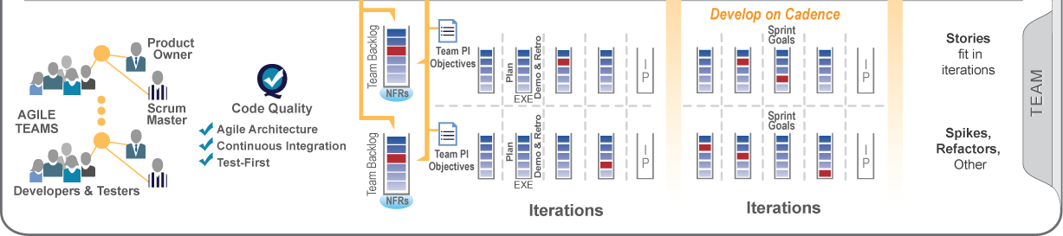
Nothing Beats an Agile Team
Empowered, self-organizing, self-managing, cross-functional team
Delivers valuable, tested, working software every two weeks
Scrum project management and XP-inspired technical practices; Kanban for flow
Value delivery via User Stories

Slide 40
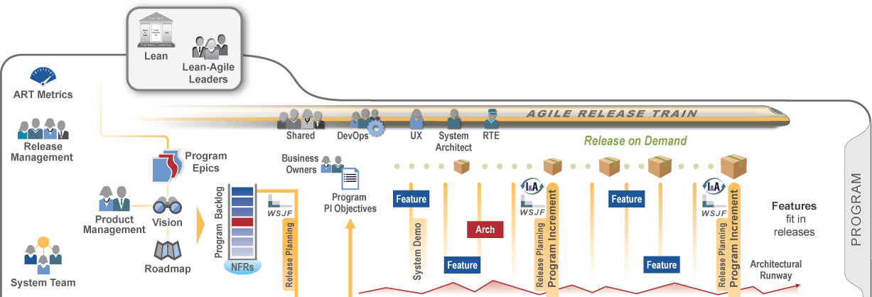
Except a Team of Agile Teams
Self-organizing, self-managing team-of-agile-teams
Delivers working, tested full system increments every two weeks
Operates with Vision, architecture and UX guidance
Common iteration lengths and estimating
Face-to-face release planning for collaboration, alignment, and adaptation
Value delivery via Features and Benefits

Slide 41
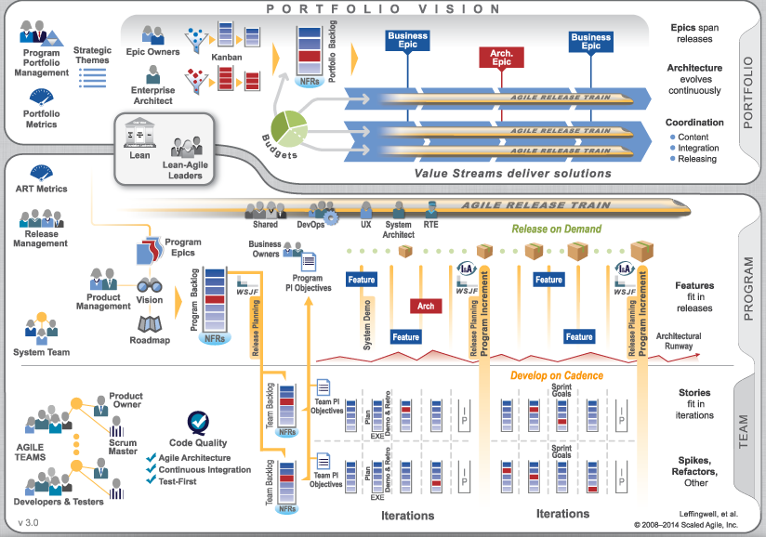
AGILE AND DEVOPS– PROGRAM LEVEL APPROACH

Slide 42

Questions?

Slide 43
Additional Resources
http://www.scaledagileframework.com/
Agile & DevOps Community of Practice
SAFe Training
Matt Takane (mtakane@redhat.com)
Google.com
Notes:
Agile and DevOps CoP: https://mojo.redhat.com/groups/agile-and-devops-community-of-practice/overview
SAFe Training: https://mojo.redhat.com/groups/agile-practice-in-northeast-and-canada/projects/agilesafe-training

